Slide 1

Sportsware tutorial
CYPRESS COLLEGE

Slide 2
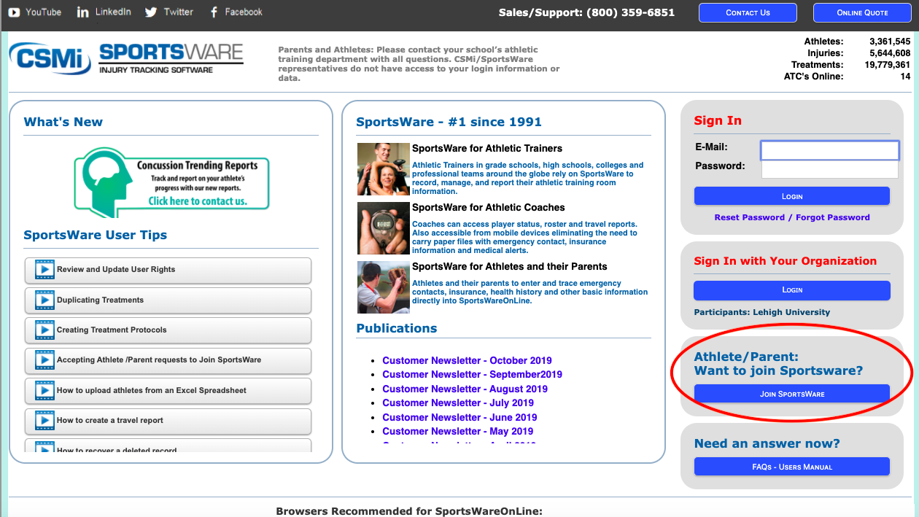
Sportsware online www.swol123.net
1. New student athletes click athlete/parent want to join Sportsware tab

Slide 3
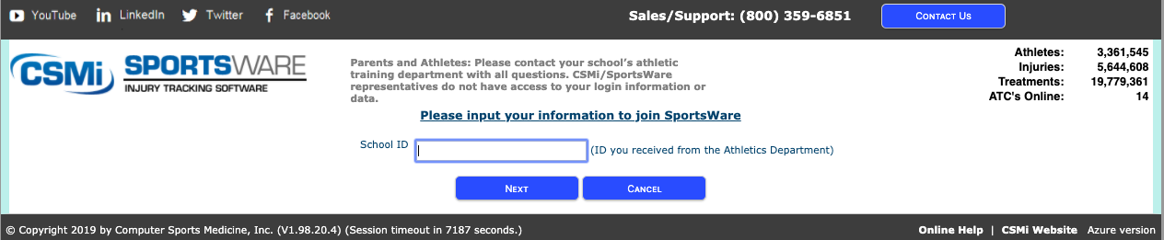
Sportsware online www.swol123.net
2. The school ID is “cypresscollege” (not your numerical student ID)
  Returning student athletes can access their existing account by logging in from the main page using their email and their previously created password. Do not ask to “Join SportsWare”
Select “NEXT”

Slide 4
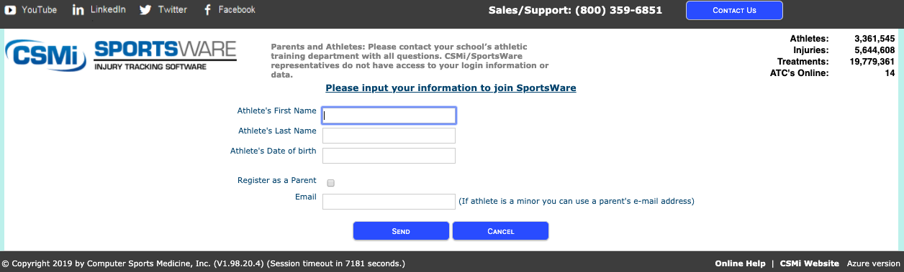
Sportsware online www.swol123.net
3. Enter first name, last name, date of birth, and personal email
4. Click SEND
You will receive an email once your request is accepted which will allow you to set your password and login
  Please allow 24 hours to be Accepted by the Athletic Trainer

Slide 5
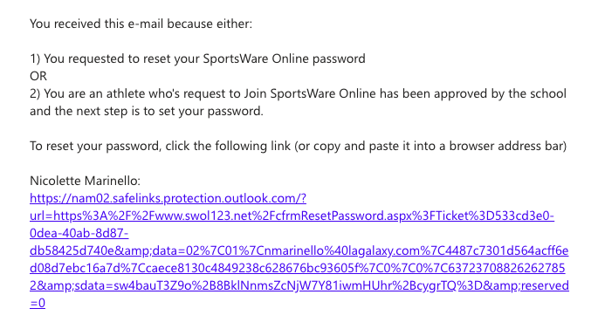
Sportsware online www.swol123.net
5. Follow the link sent to you in the email within 24 hours
  Reminder, you will not receive this email immediately, you will only receive it once your request has been accepted.

Slide 6
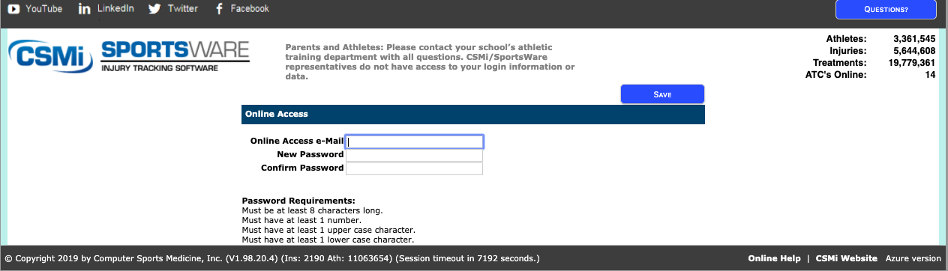
Sportsware online www.swol123.net
6. Your online access or email is your personal email
7. Make sure to follow the requirements for creating a password
8. Save and remember this information

Slide 7
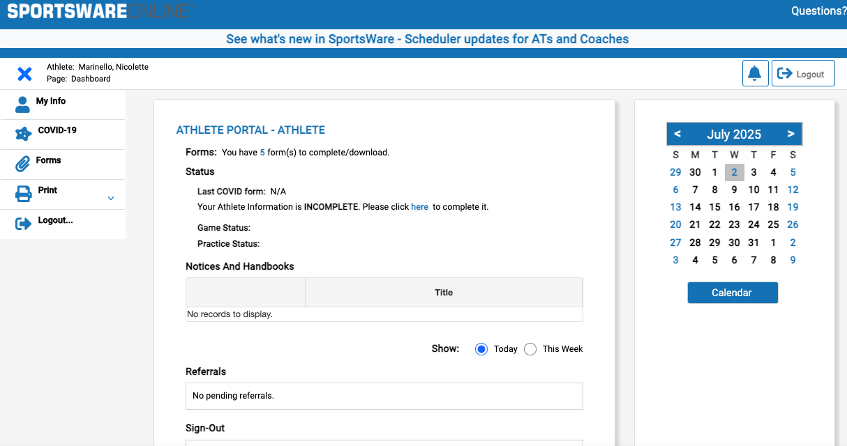
Sportsware online www.swol123.net
9. Log into Sportsware
This is your dashboard
10. Open and read all information
11. Click on the “ 5 “

Slide 8
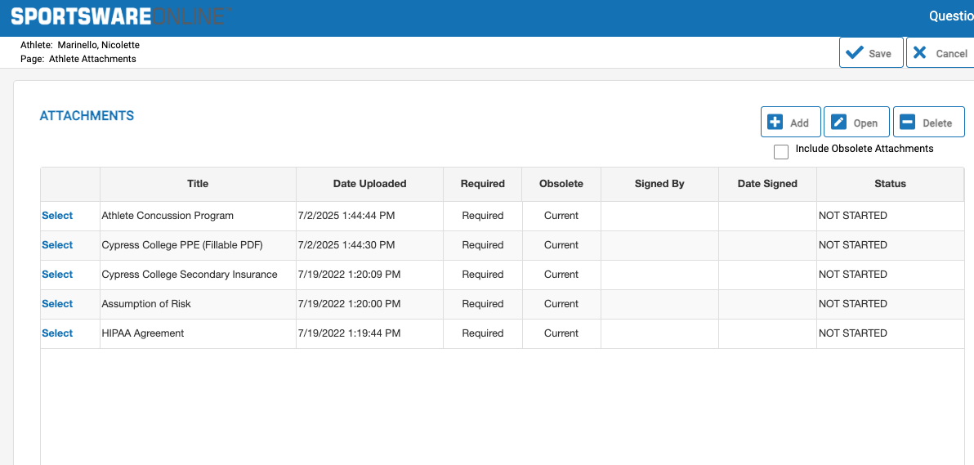
Sportsware online www.swol123.net
12. Open, sign, and complete all five forms
  Complete the following documents:
    HIPAA Form
    Assumption of Risk
    Cypress College Secondary Insurance
    Cypress College PPE Form
    Athlete Concussion Program
13. Click SAVE AND VALIDATE
14. Click CONTINUE SIGNING and signature each document

Slide 9
Sportsware online www.swol123.net
14. Click on “My Info” to access required medical information

Slide 10
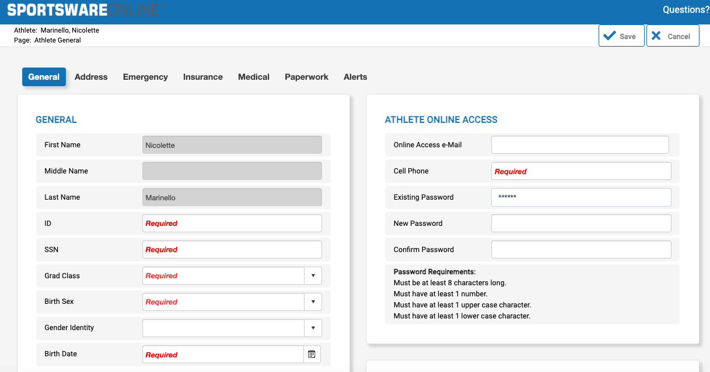
Sportsware online www.swol123.net
15. Complete ALL of the tabs
  Complete the following:
    General
    Address
    Emergency
    Insurance
    Medical
    16. Click SAVE

Slide 11
Completing Medical Eligibility
Once you have completed the Sportsware Online information, you will need to SAVE & SUBMIT and will then be prompted CONTINUE SIGNING to provide an electronic signature, which is required to complete
  Making you legally accountable for all information provided
  If you are under the age of 18—Parent/Guardian needs to provide this signature
Once you’ve electronically signed the forms to SportsWare the Athletic Trainer will review and accept
  Reminder: Incomplete/unsigned paperwork will not be accepted

Slide 12
Questions about completed Paperwork www.swol123.net
You may select the paperwork tab on SportsWare Dashboard at anytime to see if your SportsWare and or medical eligibility packet has been accepted
  Please do not call or email to see if it is complete
If you are cleared it will be denoted on your DASHBOARD
  You will be cleared to play once the Athletic Trainer has reviewed and accepted all necessary documents and your physical has been completed
Returning student athletes must update their information on SportsWare each year
  Your password and login will stay the same unless you change them
As the athlete, you are responsible for updating information
(ie: insurance, medications, etc) in SportsWare if it changes

